Slide 1
Computational Social Systems week 1
Fariba Karimi
Prof. Dr.
Computer Science Department, TU Graz
e-mail: karimi@tugraz.
web: www.networkinequality.com
Graz, 11.10.2024

Slide 2
Computational Social Science
Agenda
Motivation:
What is CSS?
Historical perspective.
Why is it important?
Topics we will cover in this course
How this course is organized

Slide 3
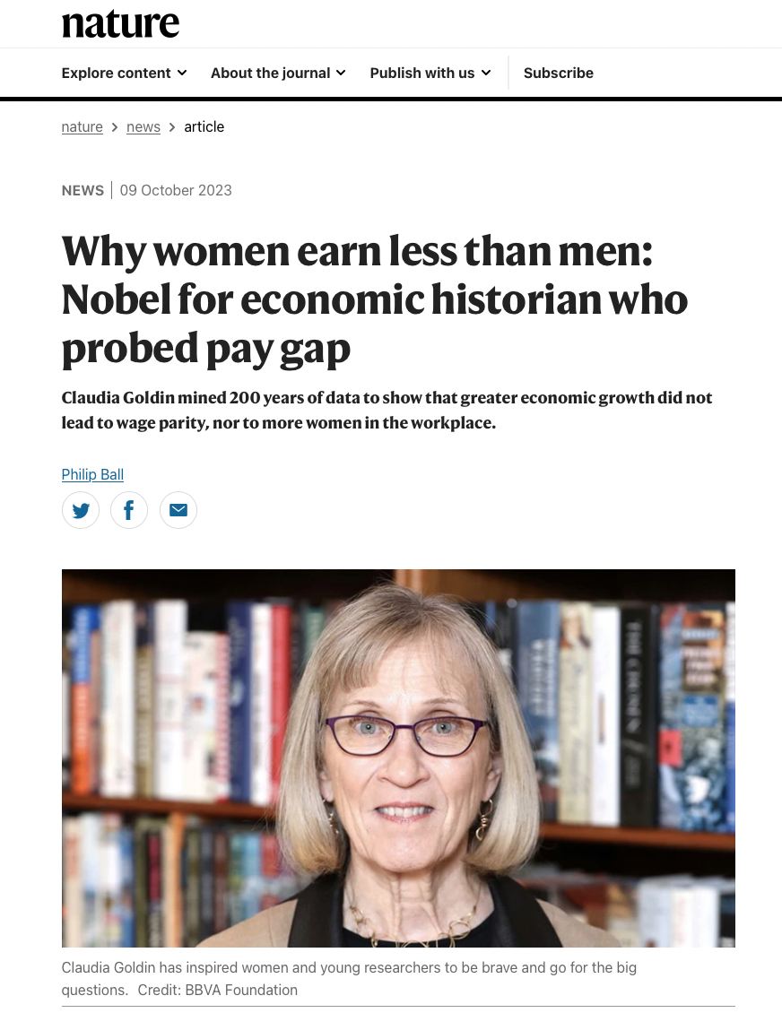
Claudia Goldin – receives the prize for her work on uncovered key drivers of gender differences in the labour market.

Slide 4
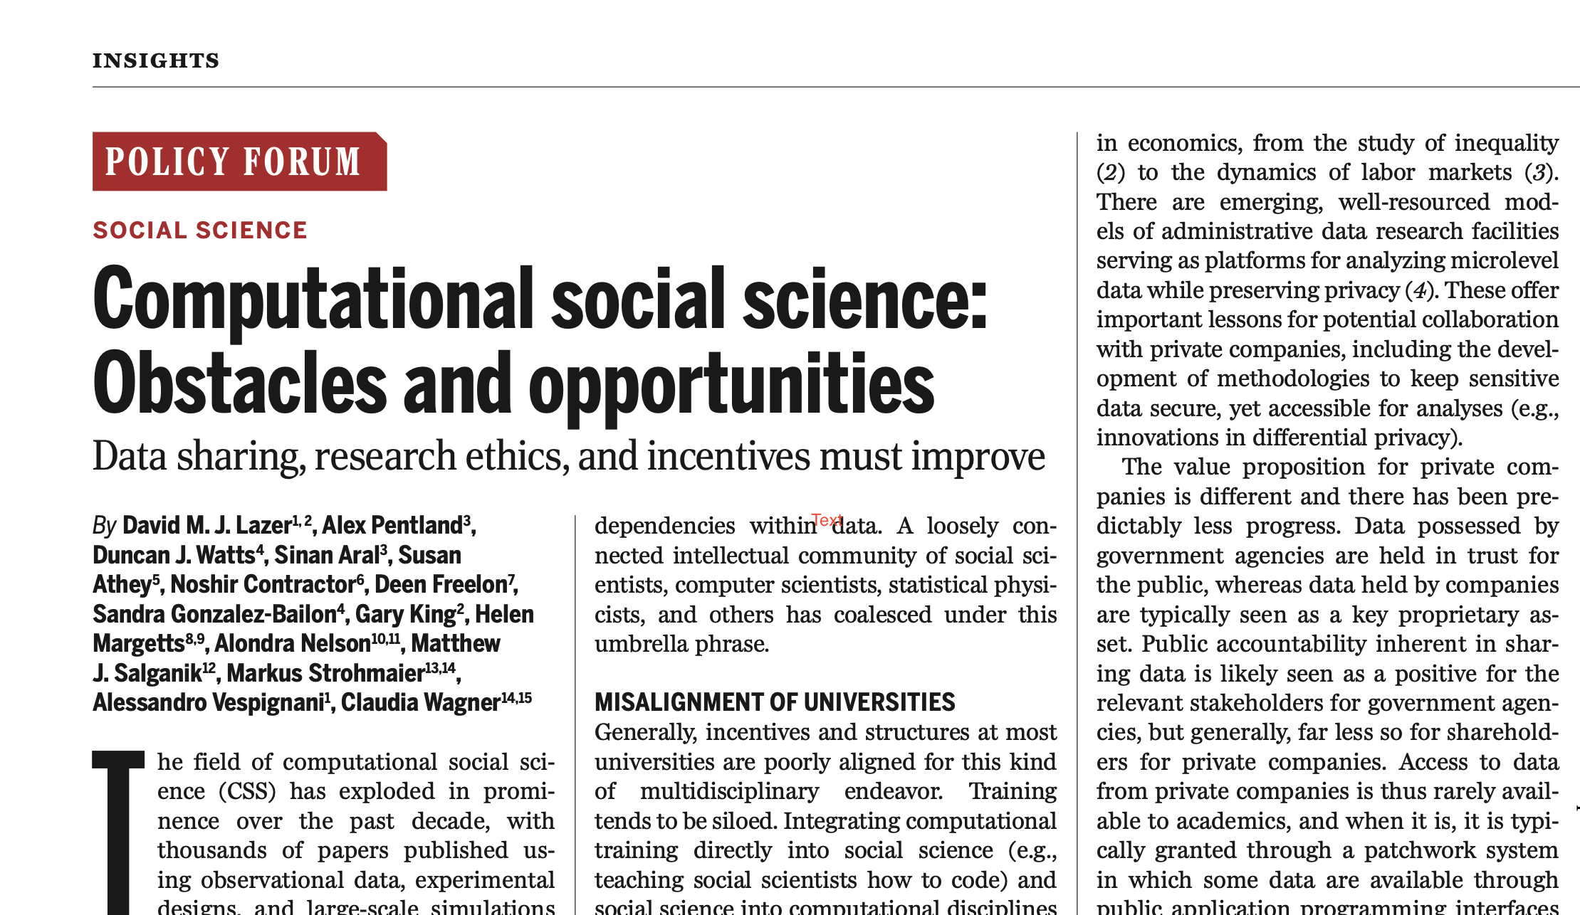
What is CSS
“computational social science is an emerging field that leverages the capacity to collect and analyze data with an unprecedented breadth and depth and scale.”
Lazer, et al. ”Computational Social Science." Science (2009)
Lazer et al,
Science (2020)
Notes:
Simulations → analyzing large datasets / amazon machanical turk / survey research
Design data: purpose of research
Found data: harness the new capabilities, how x-rays change medicine ; complement not replacement
Privacy, fairness, accountability, bias, inclusion
Explanation rather than prediction
Causal inference
Inclusion approach: better not narrow it, we want all of the above if we wish to undrestand the complex world

Slide 5

What is CSS
“Digital footprints collected from online communities and networks enable us to understand human behavior and social interactions in ways we could not do before”.
This is an emerging field of study and there is no well-defined agenda. The topics we cover here might be subject to lecturers’ knowledge and expertise.
Golder, Scott A., and Michael W. Macy. "Digital footprints: Opportunities and challenges for online social research." Annual Review of Sociology 40 (2014).
Notes:
The availability of these new datasets opens up exciting new opportunities to work towards a quantitative understanding of our complex social systems, within the realms of a new discipline known as Computational Social Science.

Slide 6
Historical perspective of (computational) social science
Chapter 0

Slide 7
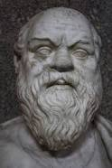
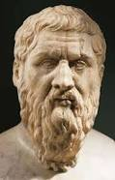
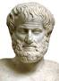
Man as a social animal
Most of the disciplines in SocSci emerged in the 19th century.
History of SocSci is much older “… already the ancient Greeks…”
Aristotle: “Man is by nature a social animal; an individual who is unsocial naturally and not accidentally is either beneath our notice or more than human. Society is something that precedes the individual. Anyone who either cannot lead the common life or is so self-sufficient as not to need to, and therefore does not partake of society, is either a beast or a god. ”
Socratic philosophers laid the fundaments of ethics and political science
Figures from Wikipedia if not mentioned otherwise
Socrates
Plato
Aristotle
Notes:
“Man is by nature a social animal; an individual who is unsocial naturally and not accidentally is either beneath our notice or more than human. Society is something that precedes the individual. Anyone who either cannot lead the common life or is so self-sufficient as not to need to, and therefore does not partake of society, is either a beast or a god. ”
The Socratic philosophers in ancient Greece were Socrates, Plato, and Aristotle. These are some of the most well-known of all Greek philosophers. Socrates (470/469–399 B.C.E.) is remembered for his teaching methods and for asking thought-provoking questions.

Slide 8
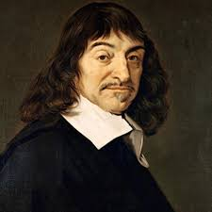
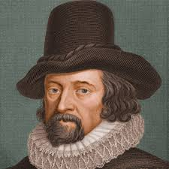
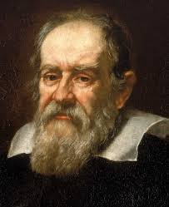
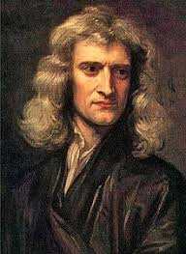
Scientific Method
Revolution in natural sciences
Descartes’ rationalism + F. Bacon, British empiricists, Galileo
Emergence of the “scientific method” in the 17th century (Newton!)
Observation (measurement) →hypothesis (induction) →consequences (deduction) → experimental/observational test →refinement of hypothesis etc.
Descartes
F. Bacon
Galileo Galieli
Newton
Notes:
Idea for a assignment: take one of the student project you have done so far; identify the

Slide 9
Scientific Method: pragmatic steps
Observation (measurement) →hypothesis (induction) →consequences (deduction) → experimental/observational test →refinement of hypothesis etc.
Define a question
Gather information and resources (observe)
Form an explanatory hypothesis
Test the hypothesis by performing an experiment and collecting data in a reproducible manner
Analyze the data
Interpret the data and draw conclusions that serve as a starting point for a new hypothesis
Publish results
Retest (frequently done by other scientists)
Notes:
Idea for a assignment: take one of the student project you have done so far; write a brief summary of the lements of a scientific method; then construct how your project address any of the steps of a scientific method. Max 4 pages

Slide 10
Scientific methods advanced sciences:
amazingly successful, first in physics (mechanics)
Mechanics explained celestial and terrestrial phenomena on the same footing, with unprecedented precision (enabled discovery of new planets)
Soon further branches of physics (thermodynamics, electricity) and chemistry followed with severe consequences on applications (industrial revolution).
Notes:
“Philosophy [nature] is written in that great book which ever is before our eyes -- I mean the universe -- but we cannot understand it if we do not first learn the language and grasp the symbols in which it is written. The book is written in mathematical language, and the symbols are triangles, circles and other geometrical figures, without whose help it is impossible to comprehend a single word of it; without which one wanders in vain through a dark labyrinth.”

Slide 11
Scientific methods advanced sciences:
amazingly successful, first in physics (mechanics)
Mechanics explained celestial and terrestrial phenomena on the same footing, with unprecedented precision (enabled discovery of new planets)
Soon further branches of physics (thermodynamics, electricity) and chemistry followed with severe consequences on applications (industrial revolution).
Scientific tools evolved in parallel:
Experimental equipment (discipline specific)
Mathematics and Statistics (general)
Galileo: ”The book (of nature) is written in mathematical language” (In the original: Philosophy)
Notes:
“Philosophy [nature] is written in that great book which ever is before our eyes -- I mean the universe -- but we cannot understand it if we do not first learn the language and grasp the symbols in which it is written. The book is written in mathematical language, and the symbols are triangles, circles and other geometrical figures, without whose help it is impossible to comprehend a single word of it; without which one wanders in vain through a dark labyrinth.”

Slide 12
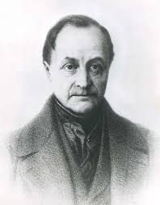
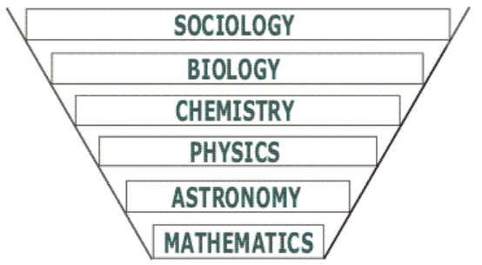
Modern Sociology
Starting from the beginning of the 19th century the success of natural sciences inspired scholars to seek for possibilities to define disciplines (instead of doing just philosophy) to which the ”method of physics” (scientific method) can be applied.
Auguste Comte (1798-1857): Sociology
Auguste Comte
Comte coined the concept of positivism; "positivity", means simply the degree to which the phenomena can be exactly determined. This, as may be readily seen, is also a measure of their relative complexity, since the exactness of a science is in inverse proportion to its complexity.
complexity
Positivity
Notes:
Comte coined the ceoncept of positivism; "positivity", mean simply the degree to which the phenomena can be exactly determined. This, as may be readily seen, is also a measure of their relative complexity, since the exactness of a science is in inverse proportion to its complexity.

Slide 13
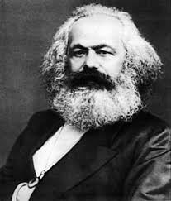
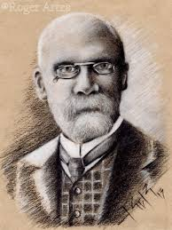
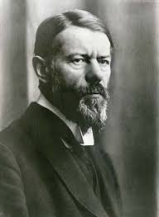
(Some of the)Founders of modern social sciences
Social science research methods:
Qualitative designs emphasize understanding of social phenomena through direct observation, communication with participants, or analysis of texts, and may stress contextual and subjective accuracy over generality.
Quantitative designs approach social phenomena through quantifiable evidence and often rely on statistical analysis of many cases (or across intentionally designed treatments in an experiment) to establish valid and reliable general claims.
Mixed-methods
Karl Marx
Emile Durkheim
Max Weber

Slide 14
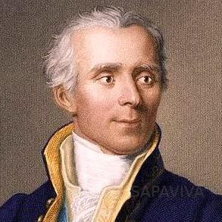
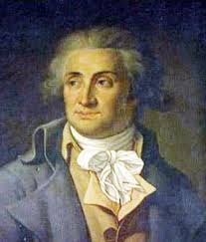
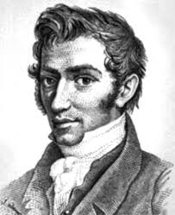
Social Physics
Pierre-Simon Laplace (”applying to the political and moral sciences the method founded upon observation and upon calculus, the method which has served us so well in the natural sciences”)
Marquis de Condercet (“Social mathematics”)
Adolphe Quetelet (“Social physics”)
They introduced and promoted statistical methods to Social sciences.
Laplace
Condercet
Quetelet

Slide 15
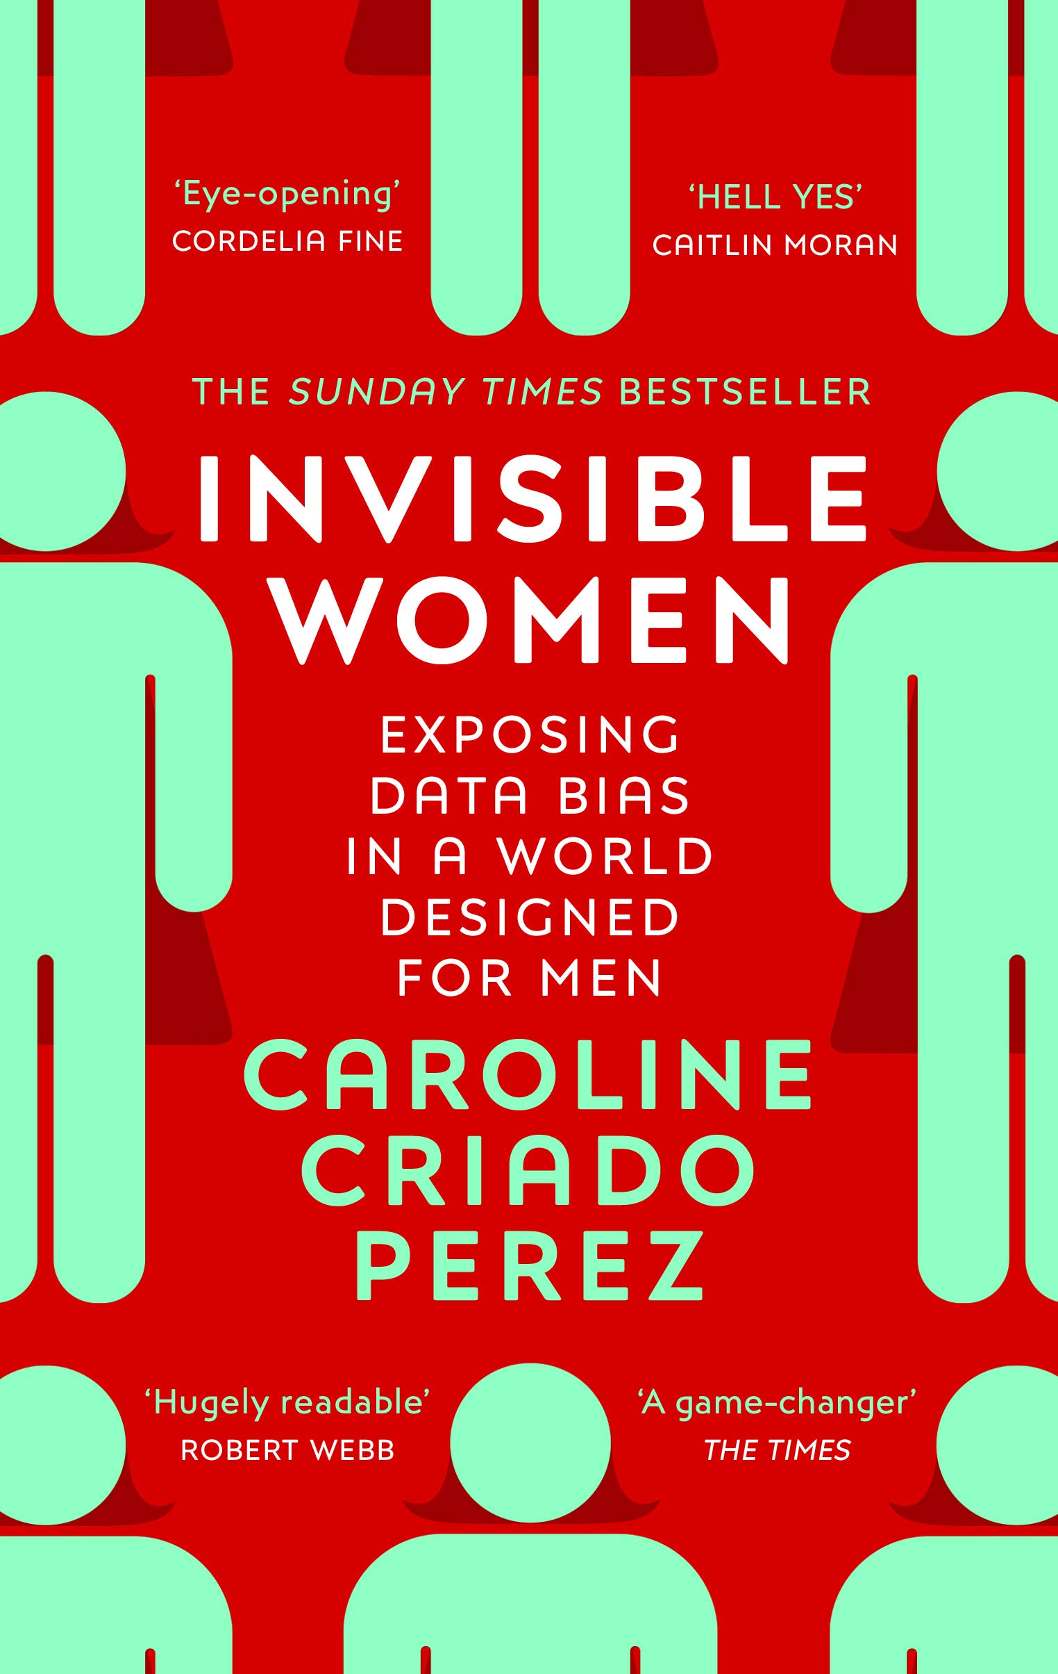
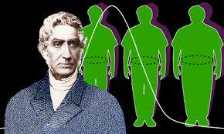
Average man and Social Atomism
Adolphe Quetelet, 1850
Some of these simplifications of social worlds into study of an average man in society can have negative societal consequences.
Notes:
Read about the history of Eugenics as a scientific discipline!

Slide 16
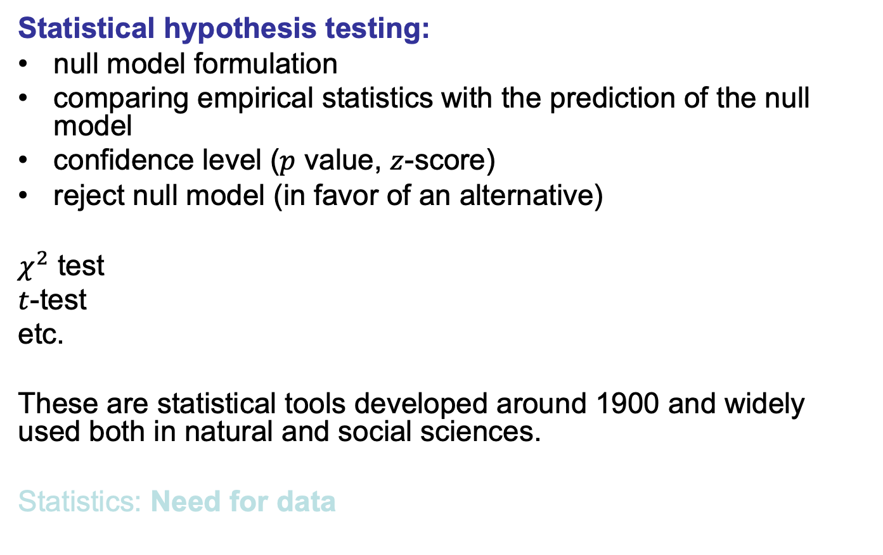
Statistical Methods: hypothesis testing
Notes:
A statistical hypothesis test is a method of statistical inference used to decide whether the data at hand sufficiently support a particular hypothesis. Hypothesis testing allows us to make probabilistic statements about population parameters.
Things are becoming quantifyable; we now need numbers and data to quantitatively study the social world

Slide 17
Data revolution
Chapter 1

Slide 18
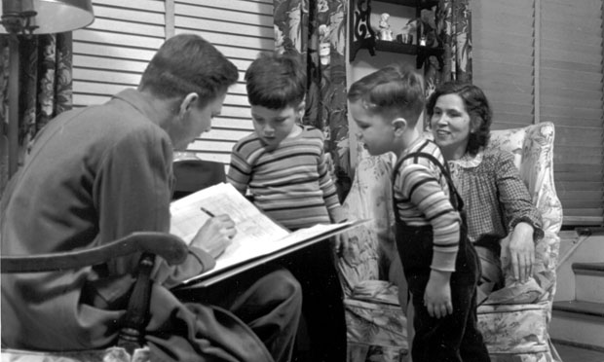
Methods of data collection in SocSci
Classical methods:
Census
Archives
Observation
Surveys (primary source of data)
Question! What are the advantages and disadvantages of this data collection method
Interview for the 1950 census. (census.gov)
Notes:
Now think about the time that social scientists had to rely on collecting datasets to study social phenomenon. One way would be census on a whole population. But that is time consuming and expensive. In that xase they had to rely on a survey of a sample of the population which might be bias or unreprestative…
Have you ever been interviewed in person or by phone?

Slide 19
Methods of data collection in SocSci
Classical methods:
Census
Archives
Observation
Surveys (primary source of data)
Advantage of surveys: Targeted questions, targeted groups, possibility of longitudinal studies.
Disadvantages: Large effort, limited size, subjectivity in answers.
Interview for the 1950 census. (census.gov)
Notes:
Now think about the time that social scientists had to rely on collecting datasets to study social phenomenon. One way would be census on a whole population. But that is time consuming and expensive. In that xase they had to rely on a survey of a sample of the population which might be bias or unreprestative…
Have you ever been interviewed in person or by phone?

Slide 20
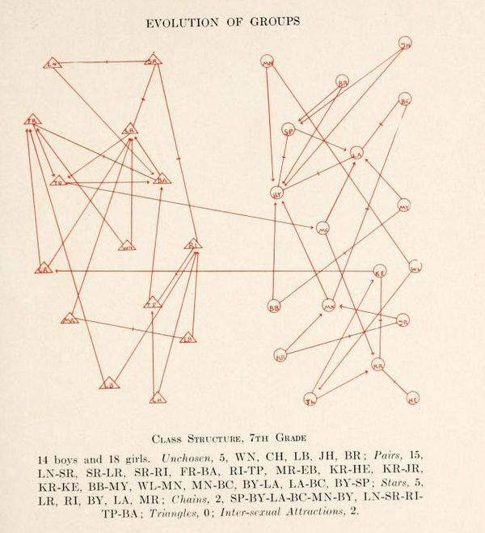
Data Revolution
Moreno used a sociogram to illustrate social attraction in a school. In this sociogram, boys are illustrated by triangles and girls are illustrated by circles. The directional arrows show attraction. Arrows with centered line are mutual attractions
Moreno, Jacob Levy. "Who shall survive?." (1953).
Notes:
Moreno one of the first scientists that coined sociograms
Moreno used a sociogram to illustrate social attraction in a school. In this sociogram, boys are illustrated by triangles and girls are illustrated by circles. The directional arrows show attraction. Arrows with centered line are mutual attractions. Taken from page 35 of Ref

Slide 21
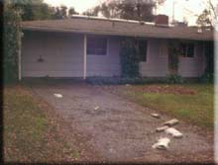
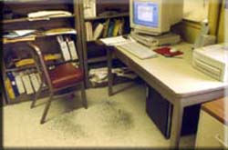
Found data in the social sciences
There are two general types of found data:
Accretion - a build-up of physical traces
Erosion - the wearing away of material
Question! Can you think of some examples?
Strohmaier, Markus, and Claudia Wagner. "Computational social science for the world wide web." IEEE Intelligent Systems 29.5 (2014): 84-88.
Notes:
Garbology:
Survey data on alcohol consumption vs. number of empty alcohol containers appearing in garbage cans. The survey data underestimated consumption due to high refusal rate and exclusion of teenage drinkers
Others: Condom wrappers 1976-1984, and beyond; Beer tabs vs. beer cans as evidence for recycling.
In US, 4th amendment issues
Floor tiles around chick exhibit
Popularity of gym apparati by chalk consumed
Popularity of library books by smudges, finger marks etc.
Leaflets in different languages in tourist sites
Postcards in museum exhibits
Paper tissue and cough medicine in campus store correlated with class attendance records

Slide 22
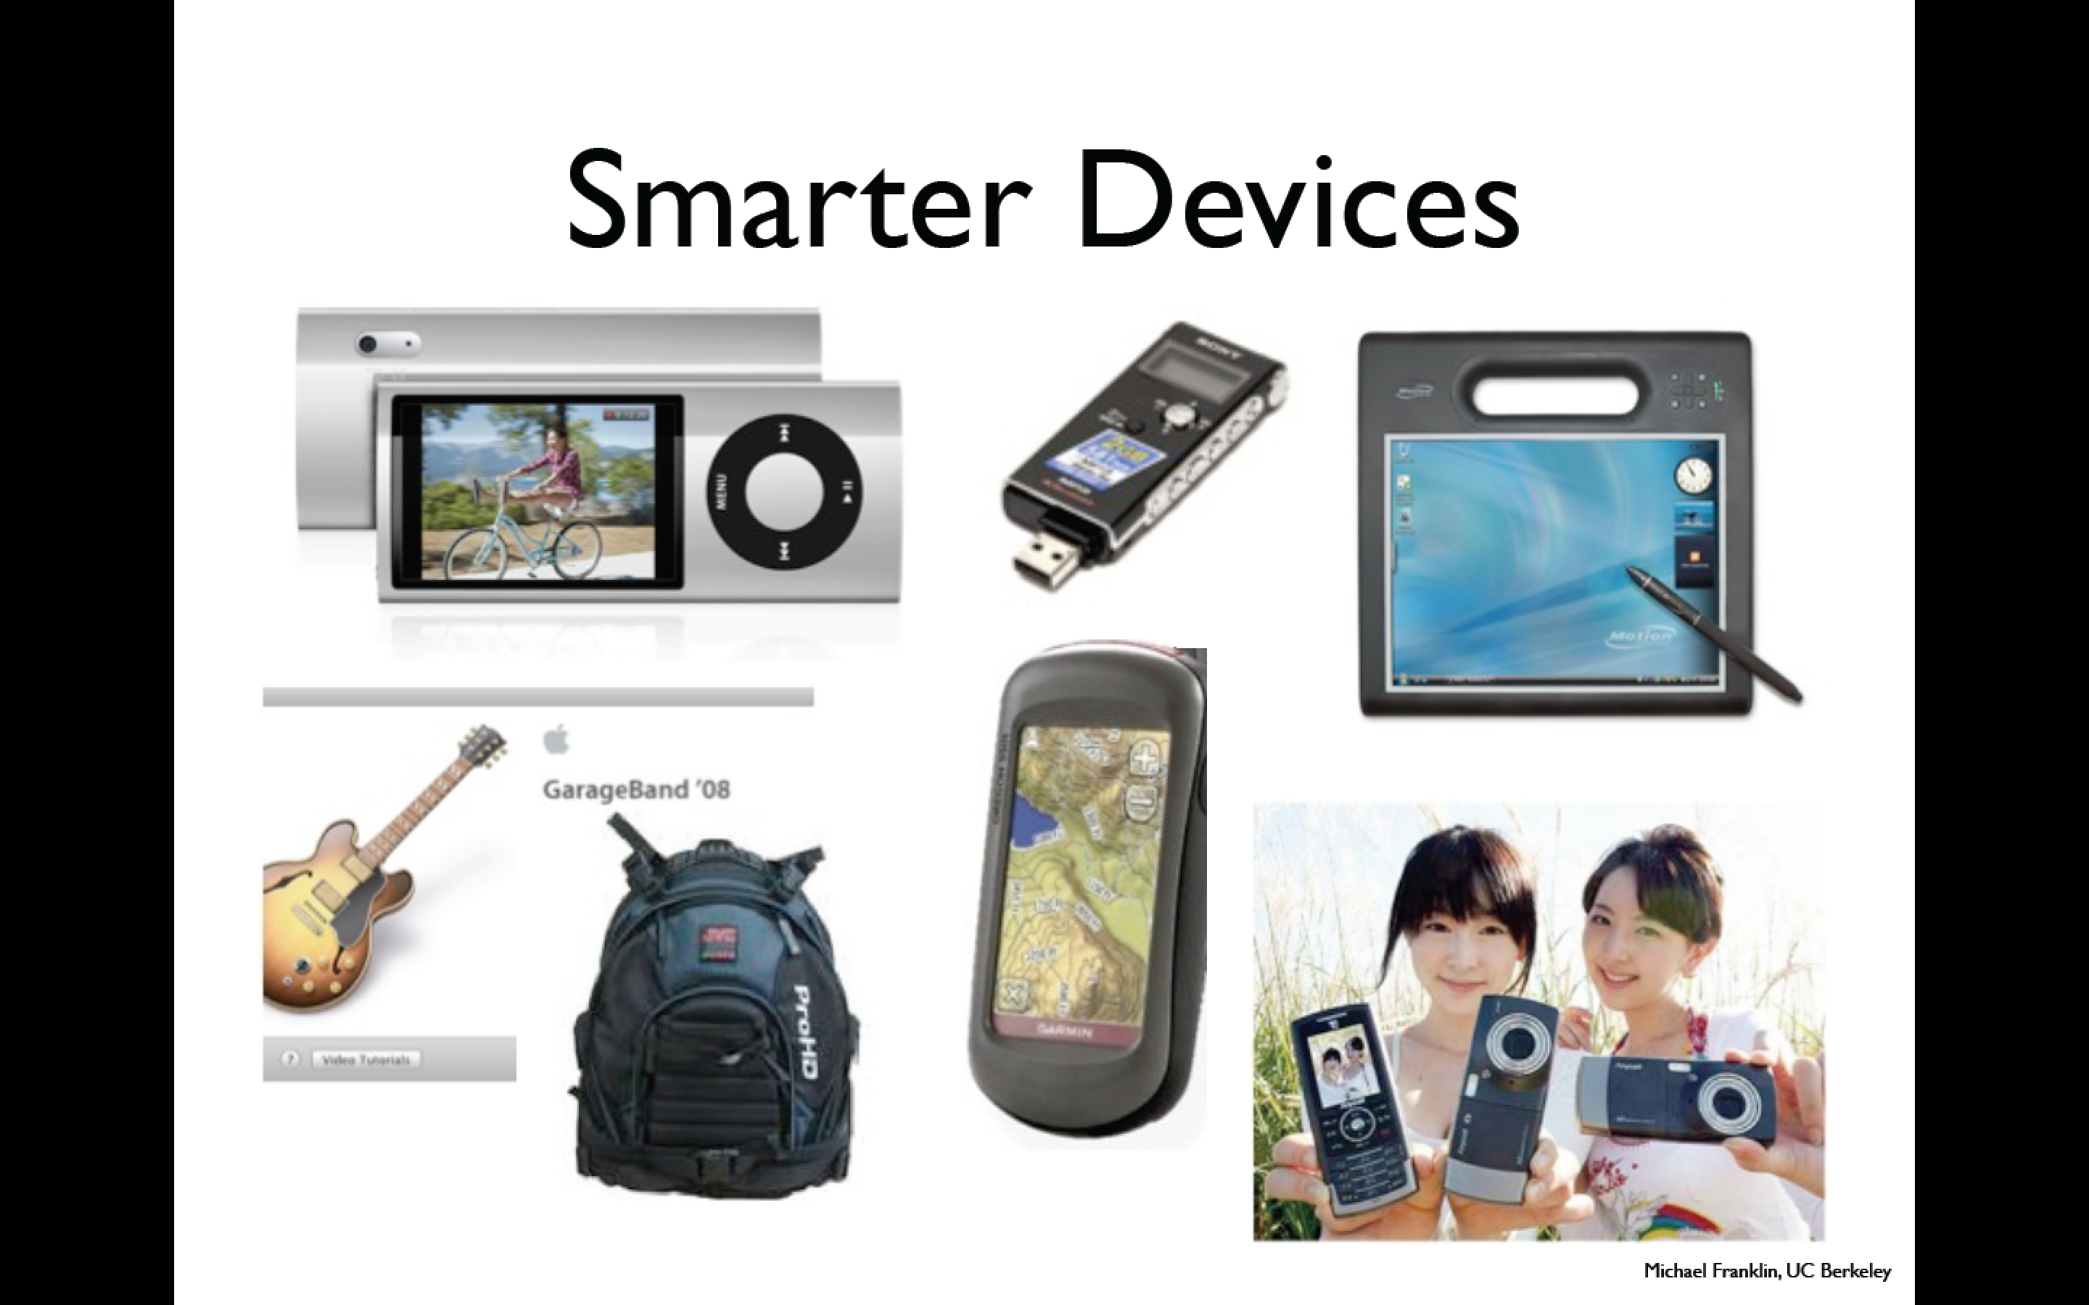
Data Revolution
Notes:
People by just going afer their ordinary life, genertae and produce a large amount of data everyday. Passively or actively
We do not only generate data actively (e.g. by uploading stuff on fb) but also passively by using smart devices.

Slide 23
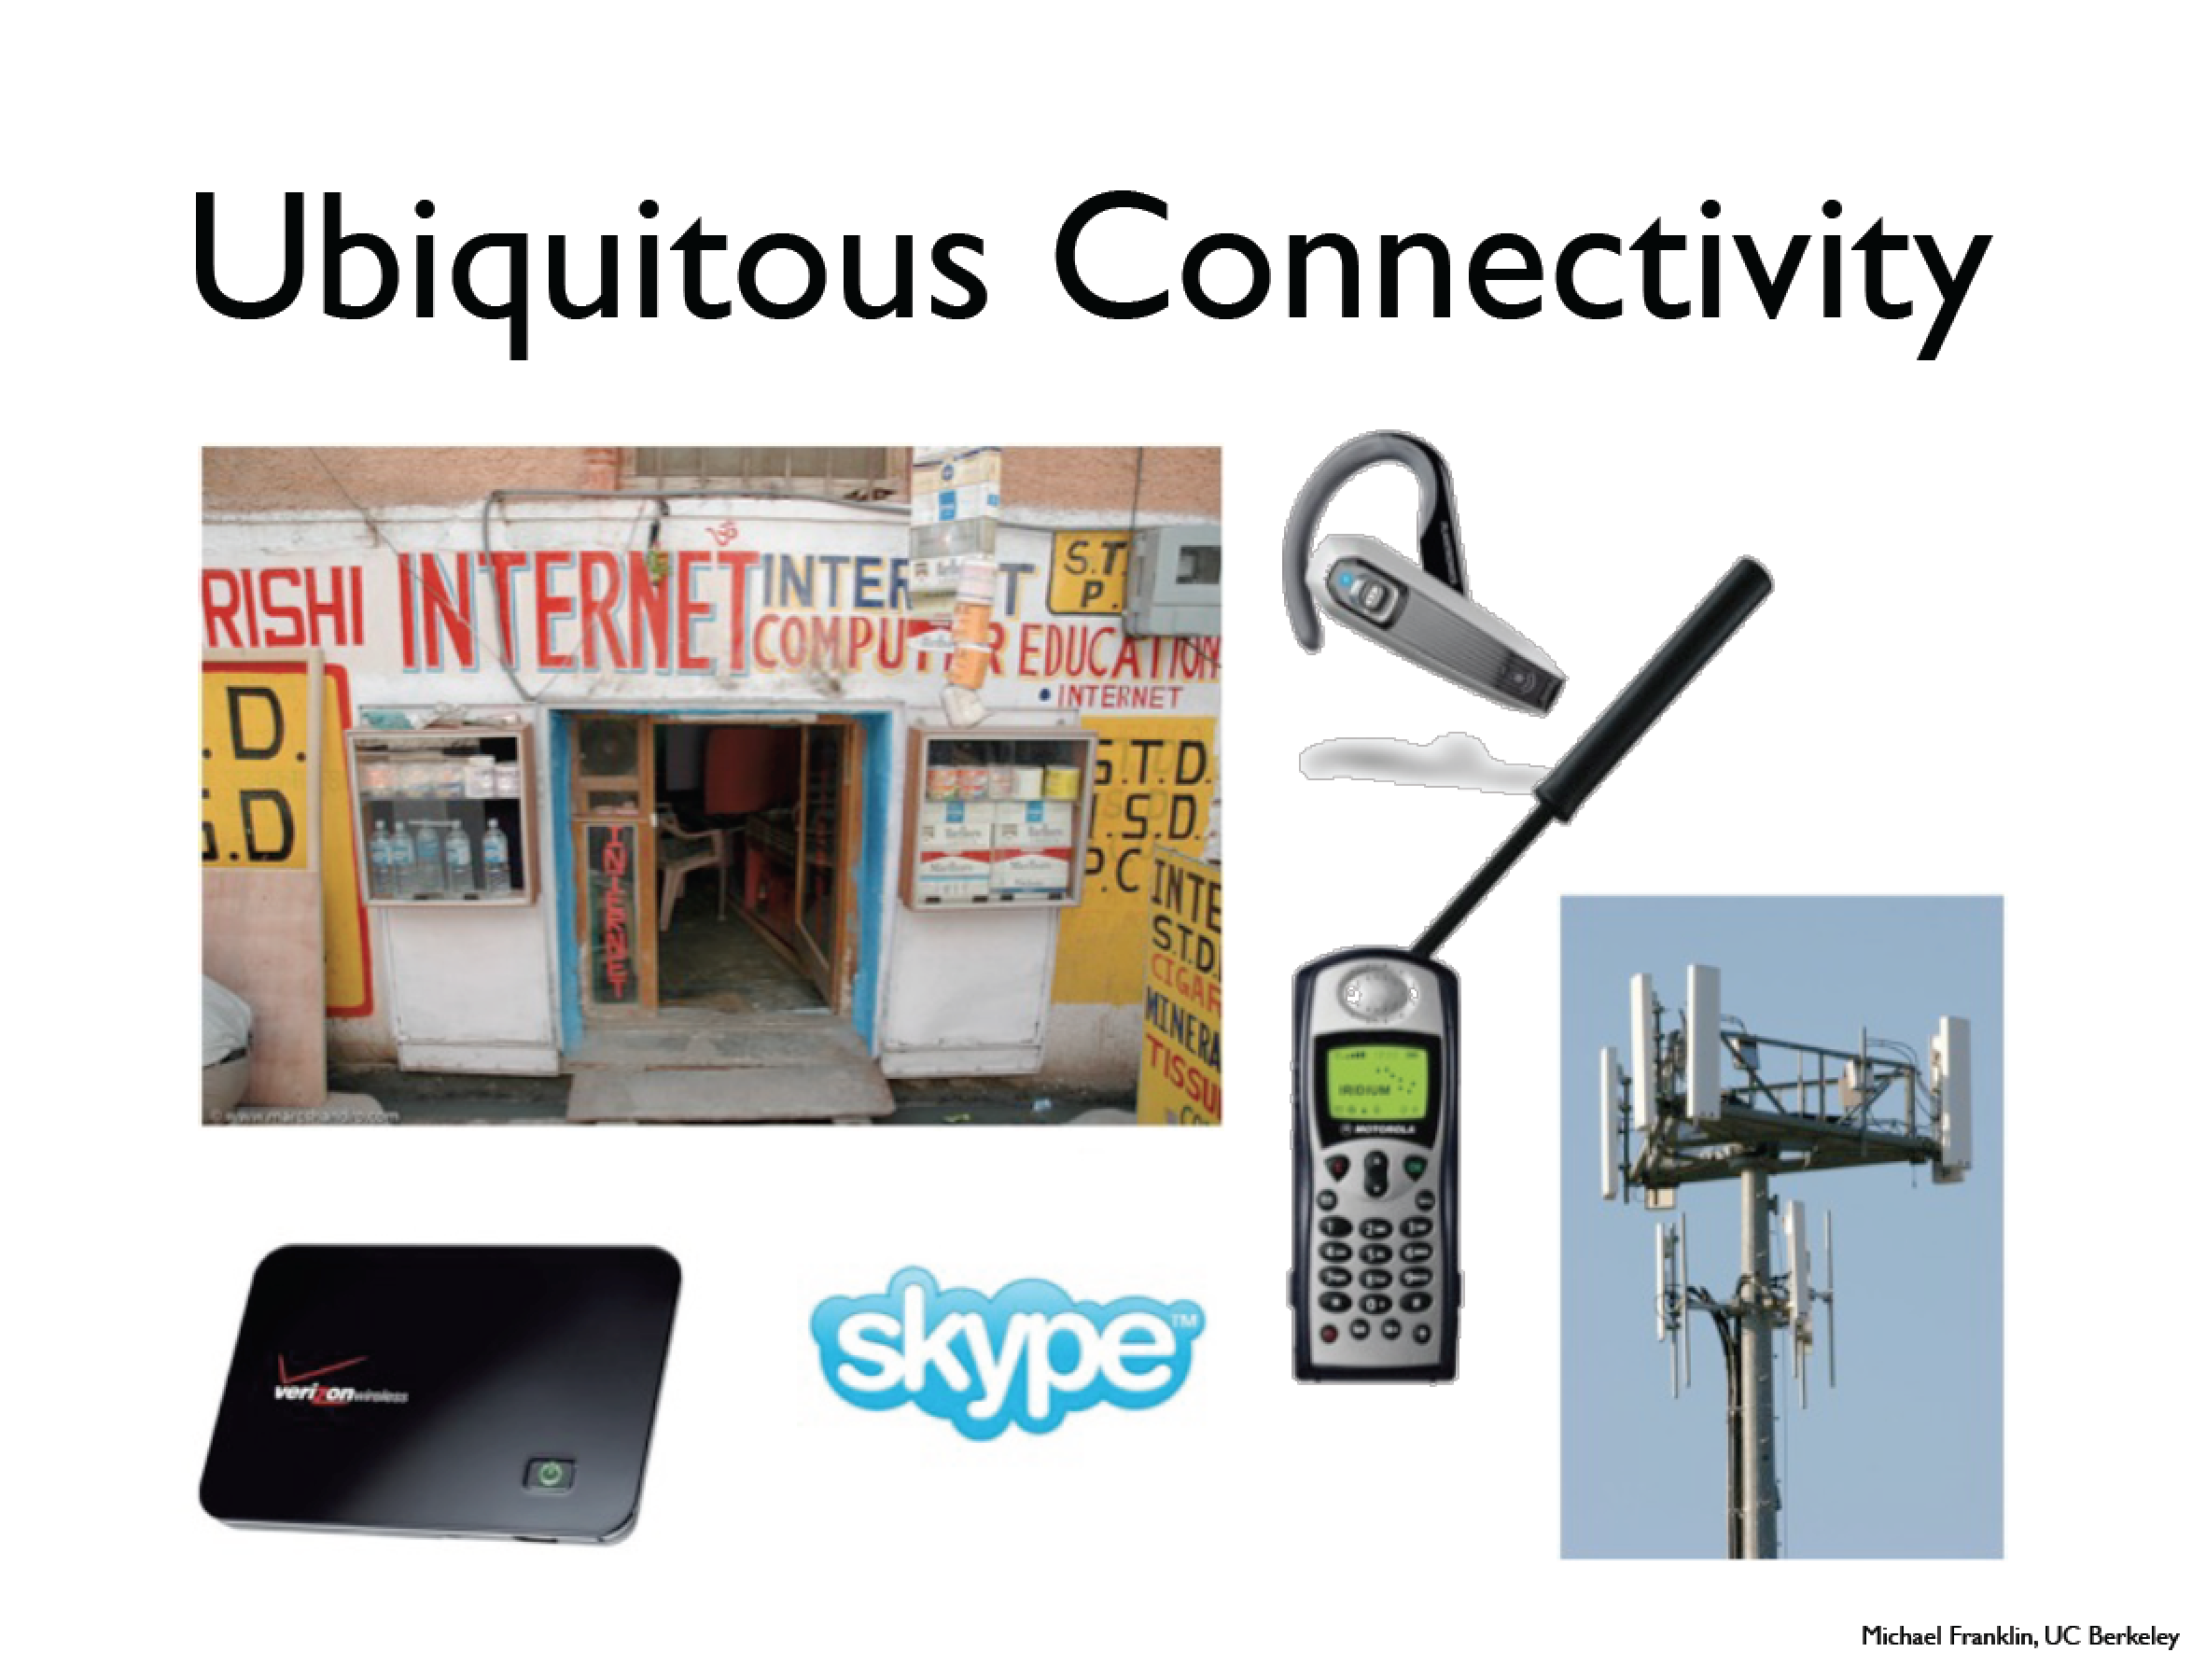
Data Revolution
Notes:
Also the ways in which we are connected are revolutionized. People that we might connect via skype can be different than those we call or send emails …

Slide 24
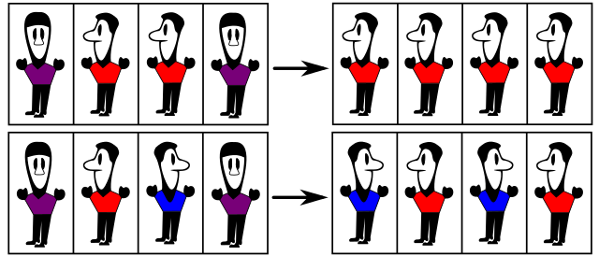
Computerization and digital revolution
Using computer simulations for building social models (Agent-based modeling: ABM)
Example of a sociophysics model inspired from Ising model in statistical physics. Social validation in Sznajd model. If two neighbors agree (top), then their neighbors agree with them. If two neighbors disagree (bottom), their neighbors begin to disagree as well.
Notes:
The Sznajd model is an extension of the Ising model and is classified as an econophysics model. It emphasizes the alignment of the neighboring spins in a phenomenon called "social validation".^{[14]} It follows the same properties as the Ising model and is extended to observe the patterns of opinion dynamics as a whole, rather than focusing on just voter dynamics.

Slide 25
Computerization and digital revolution
Using computer simulations for building social models (Agent-based modeling ABM)
Using computational powers for handling big data analysis
Notes:
The Sznajd model is an extension of the Ising model and is classified as an econophysics model. It emphasizes the alignment of the neighboring spins in a phenomenon called "social validation".^{[14]} It follows the same properties as the Ising model and is extended to observe the patterns of opinion dynamics as a whole, rather than focusing on just voter dynamics.

Slide 26
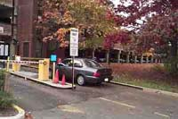


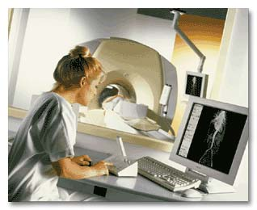

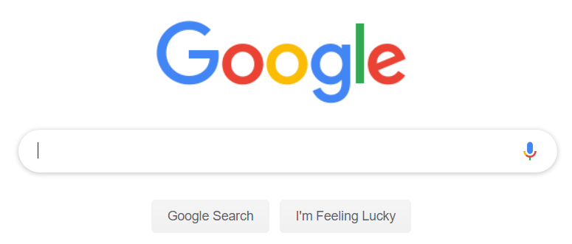
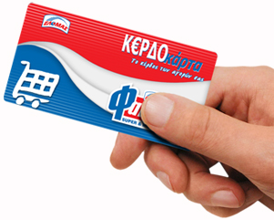



Found data on the web Digital footprints

Slide 27
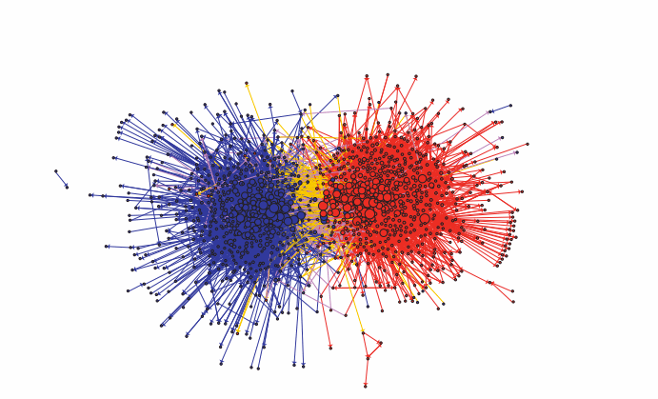
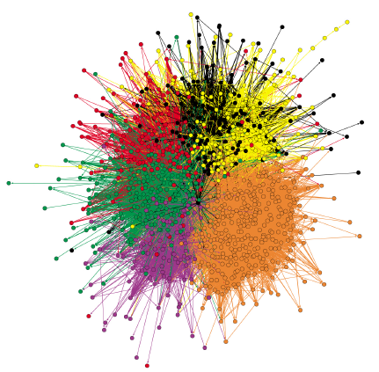
Examples of found data on the web
Polarization in Weblogs during the US 2004 election
Polarization on Twitter during the German 2013 election
Adamic, Lada A., and Natalie Glance. "The political blogosphere and the 2004 US election: divided they blog." Proceedings of the 3rd international workshop on Link discovery. ACM, 2005.
H. Lietz, C. Wagner, A. Bleier, and M. Strohmaier. When politicians talk: Assessing online conversational practices of political parties on twitter. In International AAAI Conference on Weblogs and Social Media (ICWSM2014), Ann Arbor, MI, USA, June 2-4, 2014.
Notes:
Offline phenomena spill over the online world.

Slide 28
New opportunities – new challenges
”Until now, social science has struggled to obtain tools that do more than scratch the surface of some of its questions. These range from identifying the driving forces behind violence, to the factors influencing how ideas, attitudes and prejudices spread through human populations. The available tools have largely remained in a time warp, consisting of analyses of national censuses, small-scale surveys, or lone researchers with a notebook observing interactions within small groups.
Being able to automatically and remotely obtain massive amounts of continuous data opens up unprecedented opportunities for social scientists to study organizations and entire communities or populations.”
NATURE Vol 449, 11 October 2007

Slide 29
Using Big Data makes possible to study questions on empirical basis, which had been earlier impossible to deal with:
Large-scale structure of the society
Temporal patterns of communication
Multi-scale dynamics of human mobility
Mechanism of disease spreading
Social contagion (rumors, innovations)
Quantifying cultural changes
Patterns of success, creativity
Filtering fake news and identifying echo chambers
Urban planning, traffic and well-being in cities
Crime categorization and pattern identification
etc.
Many of these problems have immediate relation to applications.

Slide 30
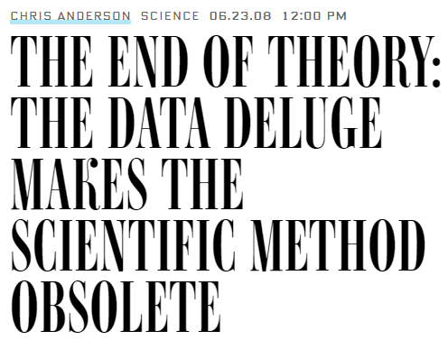
Complexity
Is it enough to have Big Data and good computers?
Wire Magazine
Notes:
question to ask students

Slide 31
Complexity
Is it enough to have Big Data and good computers?
Some think: Yes!
Wire Magazine
We think: No!
For many reasons:
Hypothesis formation is an important creative step
Data is not enough!
Many systems show unexpected, emergent behavior: complexity

Slide 32
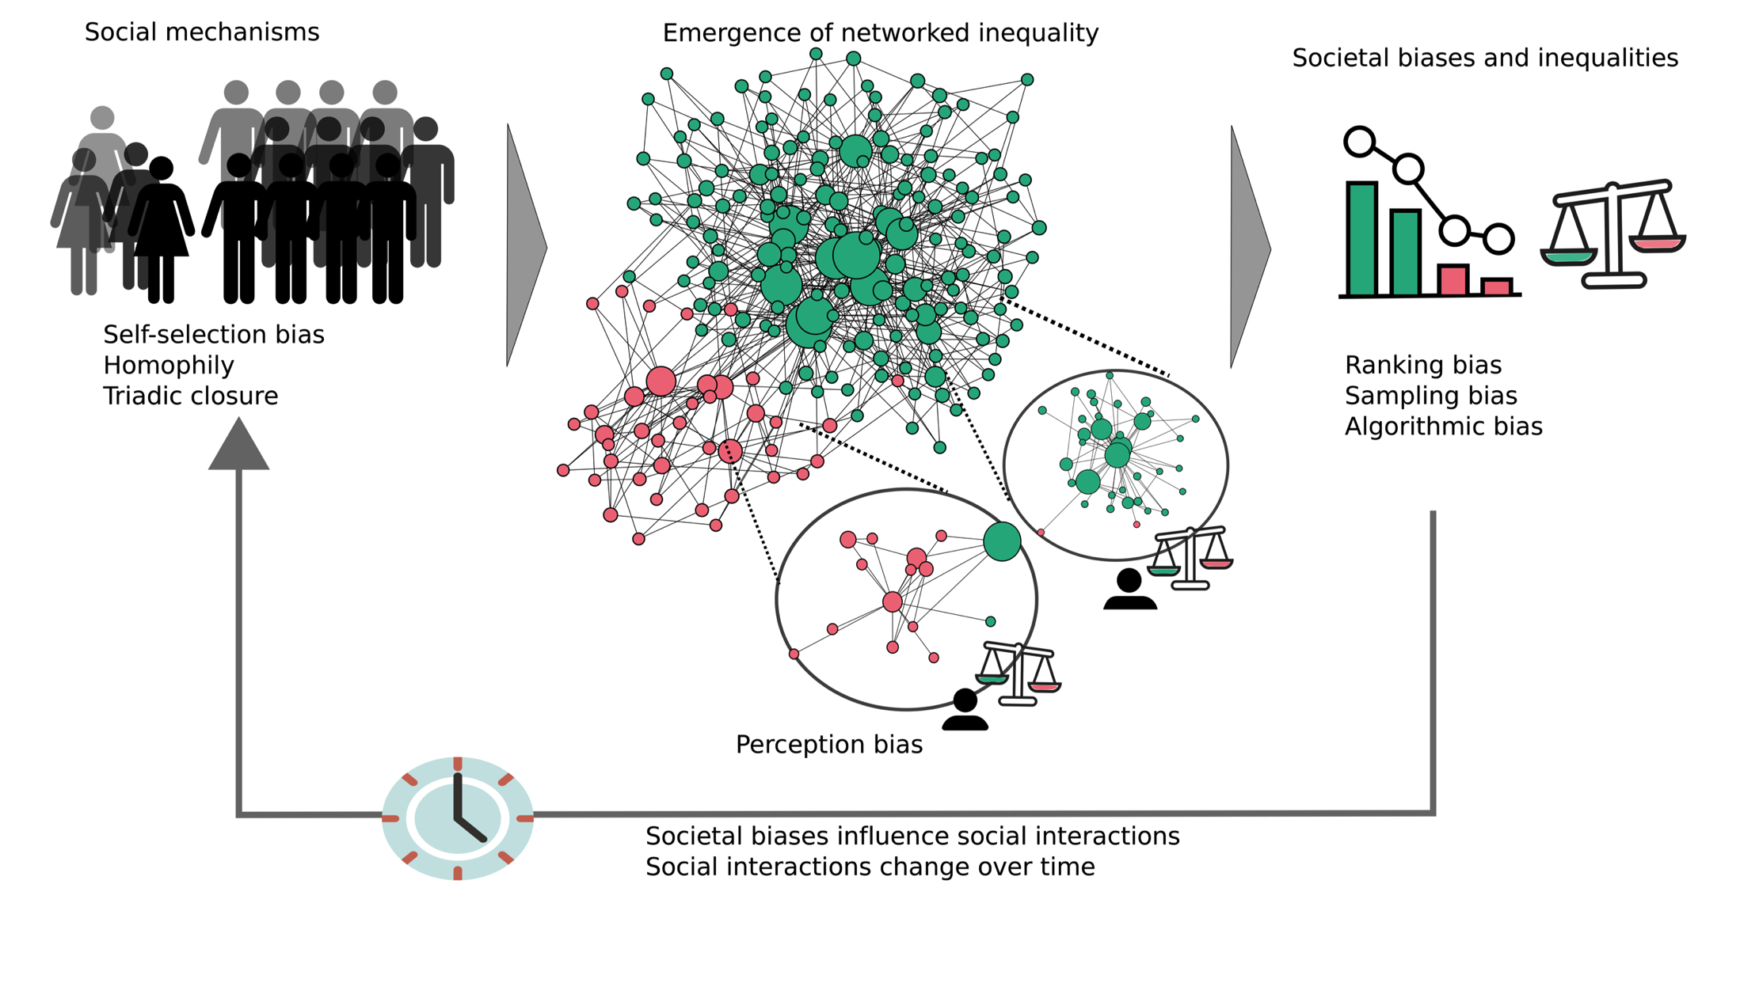
Human society as a complex system
Minorities in networks and algorithms, Karimi, Oliveira, Strohmaier. arXiv:2206.07113

Slide 33
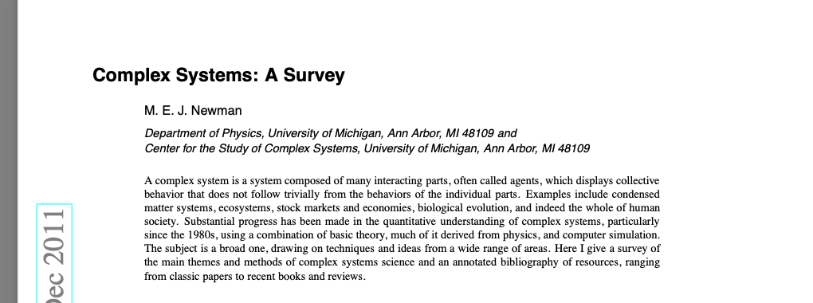
Human society as a complex system
Question to answer until next week! What is a complex system and what are its properties?
Is society a complex system?

Slide 34
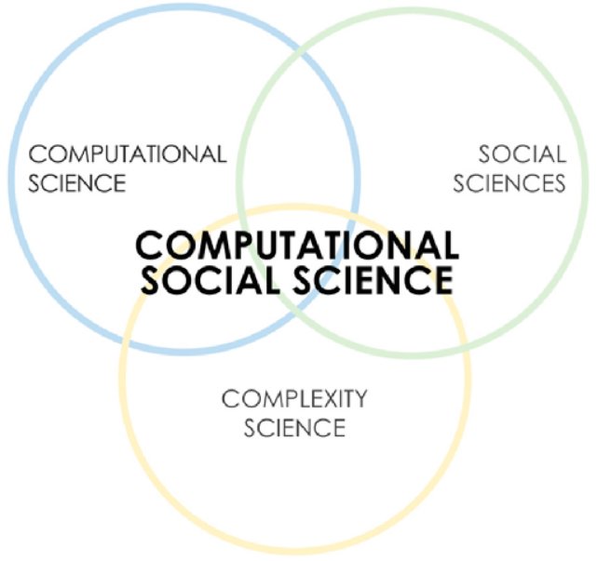
New tools needed. No single discipline is able to cope with the problems:
Multidisciplinarity is a must
Main contributing disciplines:
Sociology
Economics
Psychology
Computer Science/Data Science
Physics/Complexity Science
Network Science
Math/Statistics
Resulting in an emerging new discipline:
COMPUTATIONAL SOCIAL SCIENCE

Slide 35
Topics we cover in this course

Slide 36
Course topics overview
1. Introduction to Computational Social Systems [Slides] (11.10.2024) HS i3 (Inffeldgasse 25D) at 14:00
2. Social Impact Theory (15.10.2024)
3. Social Networks analysis (22.10.2024)
4. Social Behaviour and Trends (guest lecture: Dr. Lisette Espin-Noboa, Complexity Science Hub) (29.10.2024)
5.Methods in financial markets (05.11.2024)(guest lecture: Dr. Matthias Raddant, TU Graz)
6. Social Media Sentiment Analysis (guest lecture TBC) [Slides] (12.11.2024)
7. Cities and Complexity (19.11.2024) (guest lecture: Prof. Balazs Lengyel, Hungry)
8. Collective intelligence and collective action (guest: Prof. Mirta Galesic, Santa Fe Institue and Complexity Science Hub Vienna) (26.11.2024) [Confirmed]
9. Measuring Polarization (guest lecture: Dr. Samuel Martin-Gutierrez, Complexity Science Hub Vienna) (03.12.2024)
10. Human Societies and Cultural Evolution (10.12.2024) —> Dr. Daniel Kondor, CSH
11. Social data science and data ethics (17.12.2024) —> TBC

Slide 37
Tutorial exercises
!!! Install anaconda !!!
Tutorial session: Intro to Python 1 (15.10)
Tutorial session: Intro to Python 2 (22.10)
Tutorial session: Intro to Python 3 (29.10)
Exercise 1: Correlation of Future Orientation Index and Gross Domestic
Product (session 1) (05.11)
Exercise 1: Correlation of Future Orientation Index and Gross Domestic
Product (session 2) (12.11)
Exercise 2: Social Impact Theory with Twitter Data (session 1) (19.11)
Exercise 2: Social Impact Theory with Twitter Data (session 2) (26.11)
Exercise 3: Sentiment Evaluation of Twitter and YouTube Data (session 1) (03.12)
Exercise 3: Sentiment Evaluation of Twitter and YouTube Data (session 2) (10.12)
Exercise 4: Social Network Analysis of Swiss Politicians on Twitter Data (single session) (17.12)

Slide 38
Course logistics

Slide 39
Course team
Instructors:
Fariba Karimi
Petar Jercic
For general, course- or assignment-related questions, please use TeachCenter or approach Petar
Notes:
I don’t answer emails …

Slide 40
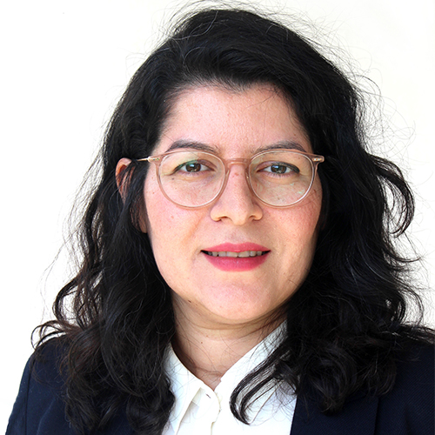
Fariba Karimi
I am a computational social scientist with a background in complex systems.
Professor of Data Science at the Dept. of Computer Science TU Graz, Austria
Group leader at Complexity Science Hub Institute,
Vienna, Austria
Interested in understanding social phenomena and inequalities using complex systems methods and data science.
http://www.frbkrm.com

Slide 41

Pavle Savković
Final year master's student in CSS.
Your tutor.
Email: pavle.savkovic@student.tugraz.at

Slide 42

Ana Jaramillo (scientific support)
PostDoc at our CSS lab in TU Graz.
For your scientific questions or ideas for master thesis, reach out to her
ana.jaramillomejia@tugraz.at

Slide 43
Course Organization and Logistics
Lectures
Tuesdays 11:00-12:30
Light lunch together ~ 30 min (bring your sandwich)
Tutorials 13:00 – 14:00
Slides etc:
Will be shared in Teach Center before the lecture starts
Communication channel: Use Forum in Teach Center or come to us after the class

Slide 44
Policies
Course documents: Assignment descriptions and lecture notes will be made available.
Deadlines: Home assignments need to be handed in on the day of the deadline.
Plagiarism: By submitting home assignments, you agree that your work will be checked for plagiarism.
Use AI tools responsibly and don’t let the AI take away your critical thinking!
If you submit plagiarized code on any home assignment, you will not be able to complete this course this year and have to repeat next year.

Slide 45
Questions?
Raise them NOW!

Slide 46
Home assignment
Pick your favorite topic and a relevant high-quality paper in CSS and write a 2-page summary about that paper; including: what you like about the paper, what you learned by reading that paper, and what you did not like about the paper.
Deadline: FRI Oct 18, 2024 @ 17:00

Slide 47
Further read
Computational social science: Making the links, Nature pages 448–450 (2012)
Manifesto of computational social science, The European Physical Journal Special Topics (2012)
5 perspective about Computational social science, Nature special issue (2021)

Slide 48
Slides based on the following resources
Yoram M Kalman. Unobtrusive Methods for Social Science Research - A Neglected Methodological Approach in the Social Sciences (slides)
Christine Hine (2011). Internet Research and Unobtrusive Methods. Social Research Update, 61, 1-4.
Michelle O’Brien (2010). Unobtrusive Research Methods – An Interpretative Essay.
CSS lecture course, Strohmaier and Wagner (2017)
CSS lecture course, Gerardo Iñiguez, CEU (2019)

